Slide 1

RUNGTA COLLEGE OF DENTAL SCIENCES & RESEARCH
TITLE OF THE TOPIC- ROOT RESORPTION
DEPARTMENT OF CONSERVATIVE DENTISTRY AND ENDODONTICS

Slide 2
Specific learning Objectives
At the end of this presentation the learner is expected to know ;
Core areas* | Domain ** | Category #
Introduction | Cognitive | Must know
Classification | Cognitive | Must know
Methods | Psychomotor | Must know
*Subtopic of importance
** Cognitive, Psychomotor or Affective
# Must know , Nice to know & Desire to know
( Table to be prepared as per the above format )

Slide 3
CONTENTS
Introduction
Definition
History
Classifications
Mechanism of resorption
Regulatory factors
Systemic regulatory factors
Local regulatory factors
Resorption due to systemic causes
Resorption due to local causes
Problems in working length determination
Role of emdogain
Periodontal regeneration
Repair of resorption
Conclusion
References

Slide 4
RESORPTION DUE TO LOCAL CAUSES
1. INFLAMMATION
a) EXTERNAL RESORPTION
Definition
The loss of cementum and/or dentin from the roots of the teeth originating in the periodontal ligament,
(Chivian 1991)
EXTERNAL RESORPTION IS OF THREE TYPES:
i) APICAL
ii) LATERAL
iii) CERVICAL

Slide 5
Apical external root resorption
External apical root resorption is a pathological condition, characterized by the resorption of hard tissues (cementum, dentin) and sustained by a local inflammatory reaction, in most cases because of the presence of infected necrotic dental pulp, which is able to maintain the whole process. Hammarstrom & Lindskog 1985
CAUSES
Infected necrotic pulp caused by caries (predominant cause) or trauma especially intrusive injuries or over instrumentation during endodontic therapy
All causes of apical periodontitis

Slide 6
Occurs mainly in the apex
High conc of toxins – enough to destroy the periodontium (Chivian & Trope 1994)
Junc. - cementum & dentin at foramen provides an extremely thin protective layer compared to other areas of root. (Kuttler 1955)
Cementum & dentin may fail to meet in a certain cases, exposing mineralized dentin to resorptive clastic cells
Lack of protective nature of intermediate cementum
May be a normal physiologic process of apical remodelling, exacerbated by pathosis.(Mauleg et al 1996)

Slide 7
Clinical evaluation
Asymptomatic but clinical symptoms might be associated with apical periodontitis.
Teeth with irreversible pulpitis had the least resorption. Necrotic pulp is more likely to demonstrate apical resorption. (Malueg et al 1996)

Slide 8
Histologic appearance- 3 types
Periforaminal resorption
Defined as the area of resorption not comprising the outline of the foramen, but the surrounding area
Foraminal resorption
Defined as the resorption within the outline or perimeter of the foramen
Combined
Vier & Figueiredo 2002

Slide 9
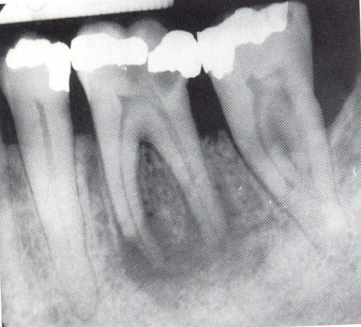
Radiographic appearance
Slight resorption of the root at CDJ is seen but usually not apparent.
If extensive ,changes are seen in the local anatomy and loss in the normal apical root shape – apical remodelling. Widening of PDL space and resorption of adjacent bone is seen.

Slide 10
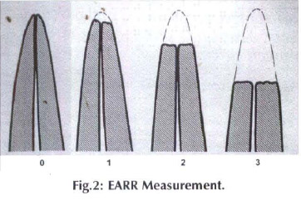
A four-grade ordinal scale to determine the degree of EARR
Sharpe et al
0= No apical root resorption
1= Slight blunting of the root apex.
2 = Moderate resorption of root apex beyond blunting & up to one-third of root length.
3 = Excessive (severe) resorption of the root apex beyond one-third of the root length.

Slide 11
Treatment
Endo therapy for removing the stimulus. WL- Weine’s method/ Electronic measurement.
Intracanal medicaments
  Calcium hydroxide
  Ca(OH)₂ – synergestic effect in conjunction with NaOCl.
  Ca(OH)₂ effectively necrotizes the granulation tissue, and makes the necrotic tissue more soluble to NaOCl. Riccuci, Siqueira et al
  Iodine potassium iodine (IKI) + Ca(OH)2
  Electrophoretically activated copper+CH (Fuss 2002)
  Electrophoretically activated calcium hydroxide
  Activ Point
Apical closure techniques by using calcium hydroxide for apexification or MTA, Thermoplasticized gutta percha techniques or Chemically plasticized techniques

Slide 12
LATERAL SURFACE RESORPTION
External surface resorption
Small, superficial resorption cavities in the cementum and the outermost layers of the dentin, without an inflammatory reaction in the periodontal ligament
Andreason & Hjorting –Hansen (1966)

Slide 13
Nomenclature
  Transient resorption
  Root resorption associated with minor necrosis
  Necrosis-associated root resorption
  Hammarstrom & Lindskog (1992)
Features
  Least destructive form- transient phenomenon. It is a self limiting process which undergoes spontaneous destruction and repair.
  Occurs within 2-3 weeks (Ne et al 1999)

Slide 14
CLINICAL EVALUATION
Normal pulpal responses to vitality testing
RADIOGRAPHIC EVALUATION
Usually not visible on radiographs.
HISTOLOGIC EVALUATION
Small, superficial lacunae in the cementum & outermost layer of dentin seen.
TREATMENT
No treatment is indicated
Rarely as small excavations on root surface with normal lamina dura & periodontal space
Repair is with cementum like tissue.
Generally no significant inflammatory reaction in the adjacent PDL seen.

Slide 15
Lateral inflammatory resorption
Cause
Occurs after all luxation injuries (except the most minor) & avulsions - displacement of the tooth results in severing of the apical blood vessels.
Clinical evaluation
Usually asymptomatic, with H/O trauma.
In mature teeth, usually by three weeks, the necrotic pulp will become infected.
Negative or abnormal pulp response to vitality testing.
Presence/absence of pain on percussion is seen.
In advanced stages, tooth becomes mobile & sensitive to percussion & palpation.

Slide 16
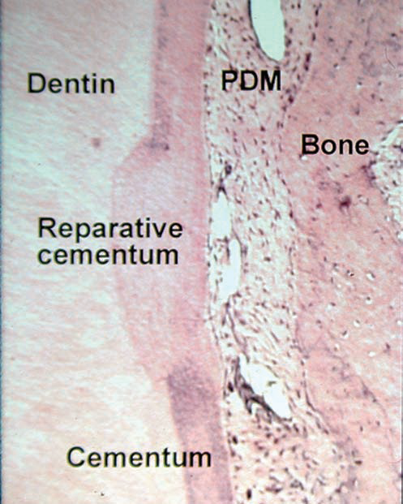
FEATURES
Root loses its cemental protection.
Bacterial toxins can now pass through the dentinal tubules & stimulate an inflammatory response in the corresponding periodontal ligament .
Resorption of the root and bone is seen
HISTOLOGIC APPEARANCE
Consists of granulation tissue with lymphocytes, plasma cells, and polymorphonuclear leukocytes

Slide 17
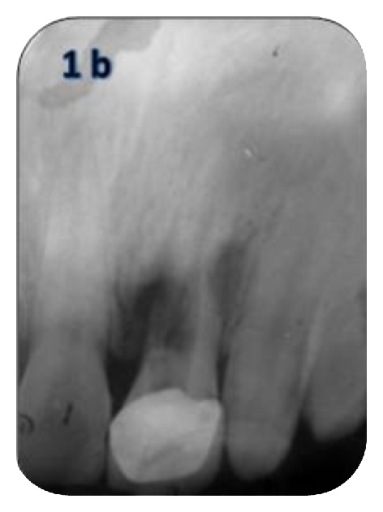
RADIOGRAPHIC APPEARANCE
Changes appear 2-3 weeks after injury
“Bowl shaped radiolucencies” in areas of root and adjacent bone.
Outline of root canal is often apparent within the radiolucent area of resorption

Slide 18
OTHER DIAGNOSTIC AIDS
Angled radiographs
Digital radiographs
Digital substraction radiographs
Computed tomography
Tuned apperture computed tomography

Slide 19

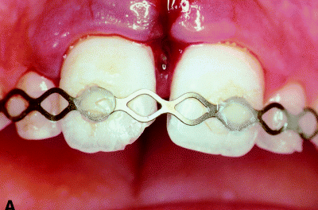
TREATMENT
INITIAL PHASE (PREVENTIVE PHASE)
Minimizing Additional Damage after the Injury
In case of luxations, gentle repositioning of the tooth In case of splinting, functional splint for 7-10 days.

Slide 20
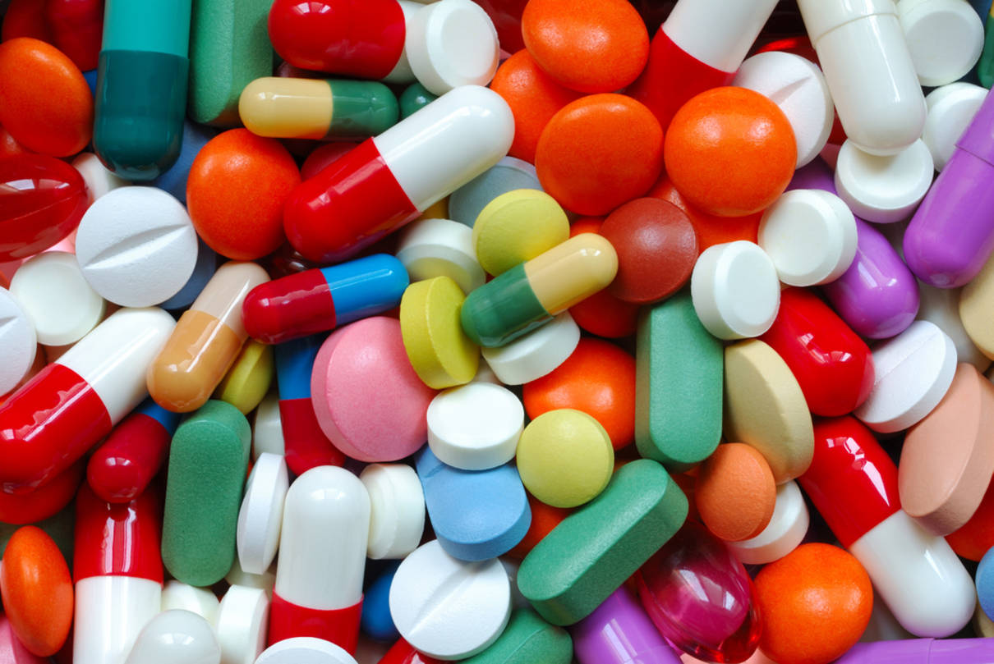
2. Pharmacological manipulation (shut down) of the initial inflammatory response
Tetracyclines, Glucocorticoids eg. Topical dexamethasone, Bisphoshonates eg. Alendronate or Combination e.g. Ledermix [tetracyclinedemethylchlortetracycline & corticosteroid -trimcinolone acetonide].
ART (Antiresorptive Regenerative Therapy ) by Pohl et al 2005
    Local application of a glucocorticoid
    Systemic and local application of tetracyclines
    Use of Enamel Matrix Derivative (EMD) e.g. Emdogain

Slide 21
3. Stimulate Cemental Healing
‘Conditioned Medium'
Supernatant of cultured gingival fibroblasts, that contain a number of biologically active factors
-ViaSpan
-Emdogain (Enamel Matrix Protein; Biora, Malmo, Sweden) _ For teeth with extended extra oral dry times
4. Slow down 'inevitable' osseous replacement
Fluoride, Biphosphonates and Emdogain

Slide 22
Secondary Phase
Prevention of pulp space infection
Elimination of pulp space infection
Manipulation of the inflammatory response Ledermix, Calcitonin, Biphosphonates, amino acids like taurine.
Notes:
Ledermix is a drug combining tetracycline (demethylchlortetracycline) and corticosteroid (trimcinolone acetonide) and has a synergistic effect on the inhibition of root resorption. It eliminates pulp space infectin as well as suppresses inflammation.
-Calcitonin ³¹
It is a polypeptide hormone. Resorbing cells are the only cells that have receptors for calcitonin. Use has been proposed in an attempt to control the resorption process
Functions of calcitonin:
-Directly inhibits osteoclastic activity, both in vivo and in vitro
-The motility of osteoclasts is suppressed
-Disappearance of clear zone
-Overall decrease in the size of the cells
-Suppresses inflammation

Slide 23
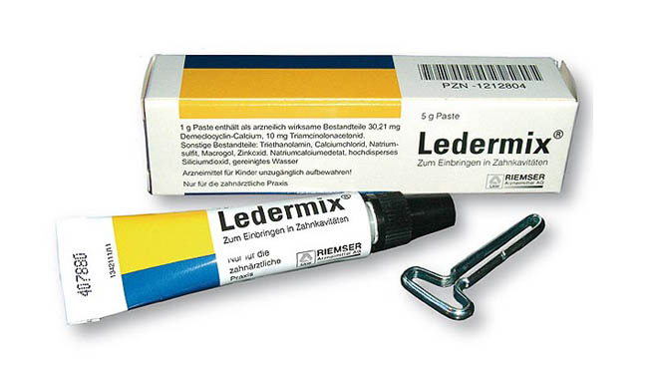
LEDERMIX
A drug combining tetracycline (demethylchlortetracycline) and corticosteroid (trimcinolone acetonide)
Synergistic effect on the inhibition of root resorption.
Eliminates pulp space infection as well as suppresses inflammation.

Slide 24
CALCITONIN
It is a polypeptide hormone. Resorbing cells are the only cells that have receptors for calcitonin. Use has been proposed in an attempt to control the resorption process
Functions of calcitonin:
-Directly inhibits osteoclastic activity, both in vivo and in vitro
-The motility of osteoclasts is suppressed
-Disappearance of clear zone
-Overall decrease in the size of the cells
-Suppresses inflammation

Slide 25

External cervical root resorption
ERR assoc with marginal periodontitis without pulpal involvement is MC referred to as cervical invasive root resorption (because of the marginal location of the defect)
Insiduous and often aggressively destructive form of ERR characterized by invasion of the root by fibrovascular tissue derived from the PDL
Heithersay 1999

Slide 26
TAKE HOME MESSEGE/ FOR THE TOPIC COVERED (SUMMARY)
Tooth resorption is a perplexing problem for all dental practitioners. The etiologic factors are vague, diagnoses are educated guesses, and often the chosen treatment does not prevent the rapid disappearance of the calcified dental tissues.

Slide 27
Question & Answer Session
Write a short note on repair of resorption.
Short note on idiopathic resorption.
Short note on internal inflammatory resorption.
Write in brief classification of resorption.

Slide 28

REFERENCES

Slide 29
Martin Trope, Noah Chivian ; Root Resorption : Pathways of Pulp Cohen and Burns, 6th Edition.
Fuss Z, Tsesis I, Lin S. : Root resorption – diagnosis, classification and treatment choices based on stimulation factors. Dent Traumatol 2003:19:175-182.
M. Laux, P.V. Abbott, G. Pajarola and P.N.R. Nair : Apical inflammatory root resorption : a correlative radiographic and histological assessment : International Endodontic Journal , 33, 483-493, 2000.
Ne RP, Witherspoon DE, Glutman JL: Tooth resorption. Quintessence Int. 30:9-25, 1999.
J.O. Andreasen : Response of oral tissues to trauma. M. Torabinejad and R.D. Finkelman, inflammation and mediators of hard tissue resorption.

Slide 30


